Slide 1
A Dog’s Life
Proposal for Website

Slide 2
Site Map
Home Page
Grooming Services
Map to Store
Contact Information
How to Select good Pet

Slide 3
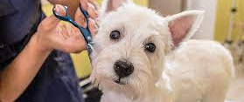



Home Page
A Dog’s Life
A Dog’s Life
Grooming Services
Come Find Us
Contact Us

Slide 4


Grooming services
Grooming
Grooming
Rated 4/4 Paws
Rated 4/4 Paws
$20
$30
$40
$50
Basic Wash
Basic Wash + Sudsy soap
Full Scrub
Premium Wash
$20
$30
$40
$50
Basic Wash
Basic Wash + Sudsy soap
Full Scrub
Premium Wash
Looking for New Pet?
Looking for New Pet?

Slide 5

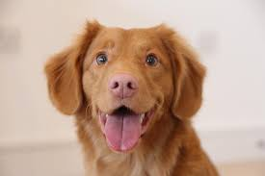
Come Find us
Looking For New Pet?
Looking For New Pet?
Hipper
Age: 2 Months
Breed: Flying hound
Shots: Fully Vaxed
Dipper
Hipper
Age: 3 Years
Breed: Walking hound
Shots: Partialy Vaxed
Dipper
Age: 2 Months
Breed: Flying hound
Shots: Fully Vaxed
Age: 3 Years
Breed: Walking hound
Shots: Partialy Vaxed

Slide 6
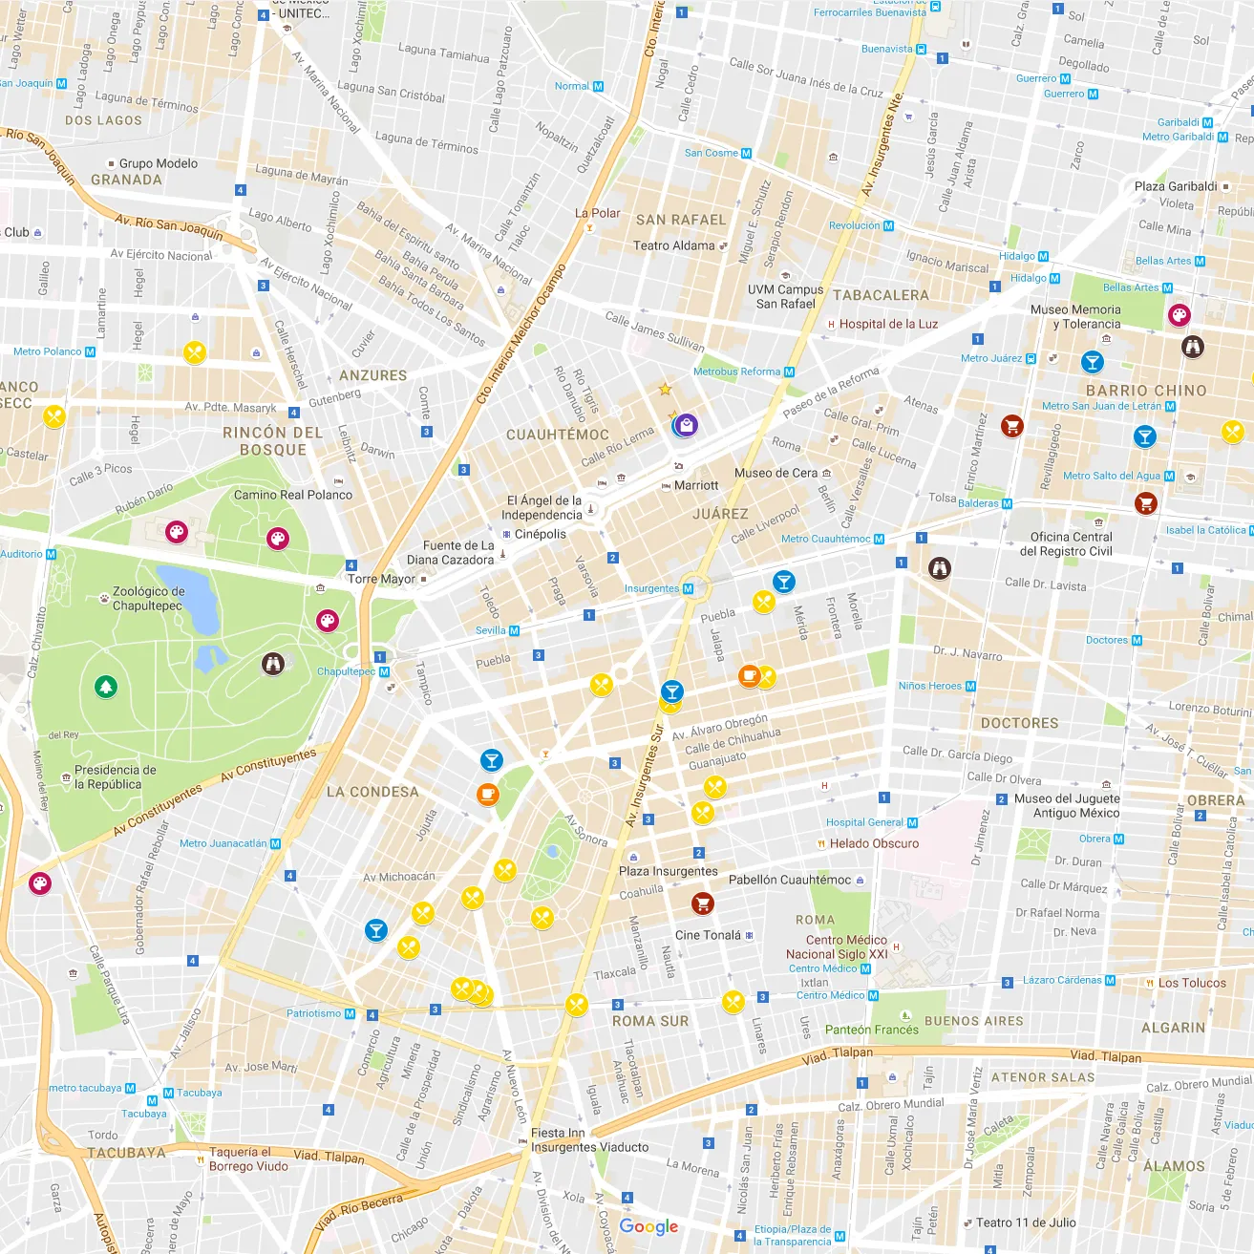
Come Find us
Come Find Us
Come Find Us
1234 E Dogson st.
12345 Dogsdale PT.
1234 E Dogson st.
12345 Dogsdale PT.

Slide 7
Contact us
Contact Us
Contact Us
Phone:
(123)456-7890
Phone:
Email:
(123)456-7890
ILUVdogs@gmail.com
Email:
ILUVdogs@gmail.com

